Slide 1

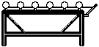
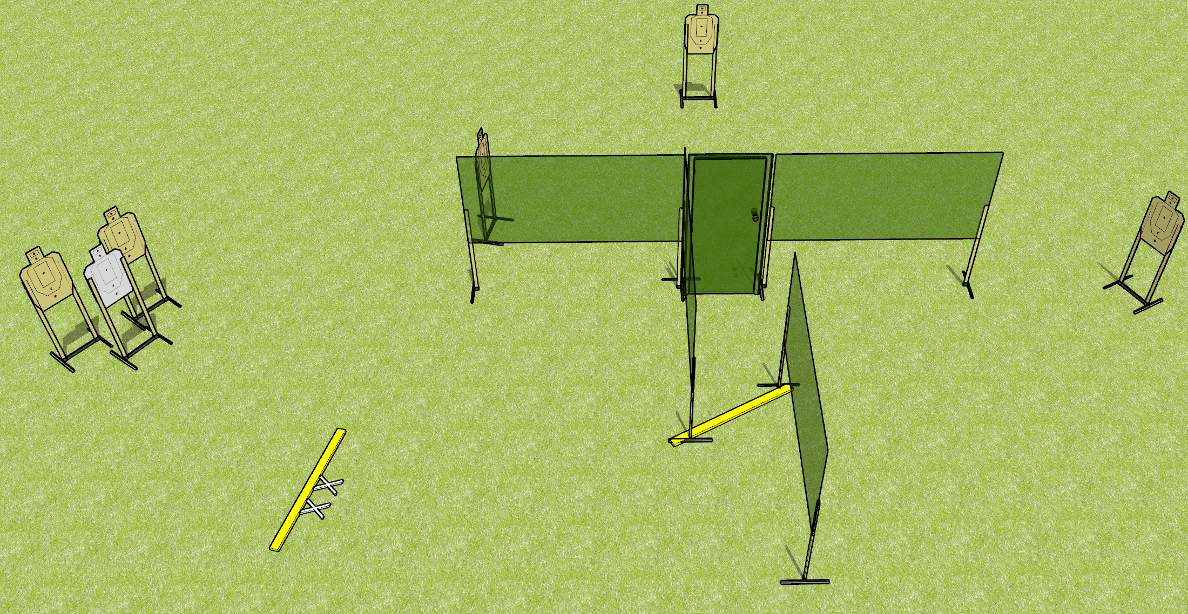


 | Dothan Gun Club – Defensive Pistol Down the hall Course Designer : Drew Coleman
START POSITION : feet touching start stick (marked with X’s on diagram). Wrists above shoulders (or low ready)
GUN READY CONDITIONS : loaded and holstered or low ready |  | SCORED HITS: 10 TARGETS: 5 paper SCORED HITS: Best 2 on paper START-STOP: Audible, last shot NOTES:
STAGE PROCEDURE: On start signal, retreat while engaging nearest targets. Perform a mandatory reload, engage target right of wall before engaging final targets in tactical priority from doorway.
P1

Slide 2
Out & Back NS
Out & Back Target
Drop Out Shoot
Drop Out Shoot
Drop Out Penalty
Drop Out Penalty
Flop-Up
Flop-Up
Can-Can Array
USP2
PP2
USP1
Flop-Up
Flop-Up
PP1
T10
Plate Flop-Up
Plate Flop-Up

Slide 3

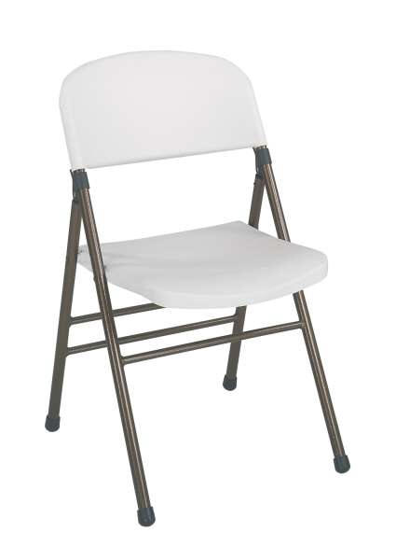
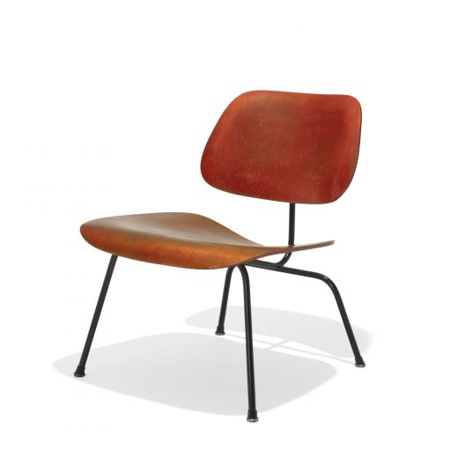
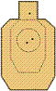
Stage
Desc.
Free Fire Zone

